Slide 1

INTERNSHIP REPORT FOR WEEK 9
MITRE ENGAGE
IMPLEMENTATION OF AFFECT GOAL
-ARUN ASHOK BADRI

Slide 2
MITRE ENGAGE AND IMPLEMENTATION OF AFFECT GOAL USING HONEYPOTS
INTERNSHIP REPORT PLAN
Month 1: Orientation and Goal Selection
Month 2: Proposal and Planning
Month 3: Implementation and Documentation

Slide 3
INTERNSHIP GOALS :
(1) read the MITRE Engage documents; each one of you needs to select one of the goals (Expose, Affect, and Elicit) to study deeper and define each action under these goals in detail.
(2) Propose possible actions to be implemented in SSH honeypot and AD honeypot. There are about 10 to 20 actions listed under each goal. Try to propose corresponding actions for these two honeypots.
(3) Real implementation: Each of you needs to implement at least four actions according to your design in (2) in the real honeypots.

Slide 4
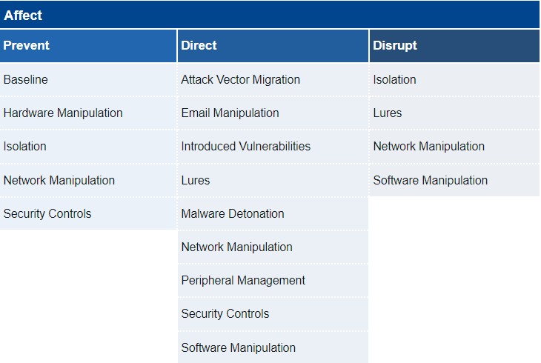


ENGAGE MATRIX- AFFECT GOAL
> LURES
> BASELINE
> INTRODUCED VULNERABILITIES
> ATTACK VECTOR MIGRATION

Slide 5
> LURES
LURES ID: EAC0005
Deceptive systems and artifacts intended to serve as decoys, breadcrumbs, or bait to elicit a specific response from the adversary.
Lures can take a variety of forms including credentials, accounts, files/directories, browser extensions/bookmarks, system processes, etc.
Lures provide opportunities to the defender to drive adversary behavior in ways that align with operational outcomes.

Slide 6
> LURES
IMPLEMENTED IN COWRIE HONEYPOT LAST WEEK
WITHOUT-LURES | WITH-LURES
ADVERSARY SEES ‘PHIL’ FS AND GETS ALERTED AND STOPS ATTACKING | ADVERSARY SEES ‘WU-CHEN’ AND OTHER USERS AND CONTINUES ATTACKING
MIGHT EXPLORE ‘PHIL’ FILE SYSTEM AS INTENDED | WE CAN DIRECT ATTACKER TO EXPLORE ‘WU-CHEN’AND OTHER DIRECTORIES
MIGHT NOT BE ABLE TO COLLECT MUCH INFORMATION ON THE ATTACKER’S TTP’S | WE CAN COLLECT MORE INFORMATION ON THE ATTACKER’S TTP’S
HAVE LEAST INTERACTION TIME | INTERACTION TIME BETWEEN SYSTEM & ATTACKER IS INCREASED

Slide 7





> LURES
IMPLEMENTED IN COWRIE HONEYPOT LAST WEEK
WITHOUT-LURES | WITH-LURES
SCANS SYS
SCANS SYS
HONEYPOT
HONEYPOT
PHIL FS
WU-CHEN FS
HACKER
DIRECTING ATTACKER
GOT ALERTED
HACKER
/IMPORTANT
/CRYPTOKEYS

Slide 8
ENGAGE MATRIX- AFFECT GOAL
> LURES
> BASELINE
> INTRODUCED VULNERABILITIES
> ATTACK VECTOR MIGRATION

Slide 9
> BASELINE
BASELINE ID: EAC0019
Identify key system elements to establish a baseline and be prepared to reset a system to that baseline when necessary.
Reverting to a Baseline configuration can be essential when restoring an operational environment to a safe state or when looking to impose a cost on adversaries by preventing their activity
For example, the defender can watch for an adversary to make changes in the environment and then revert the environment with the goal of either forcing the adversary display a new, possibly more advanced, TTP

Slide 10
> BASELINE
IMPLEMENTED IN TPOT HONEYPOT
CONSIDER A SCENARIO WHERE,
AN ADVERSARY MIGHT GAIN ACCESS TO THE HONEYPOT AND MIGHT TRY TO ACCESS THE MAIN SERVER
WITHOUT-BASELINE | WITH-BASELINE
MUST SHUT-DOWN MAIN SERVER TO PREVENT THE ATTACK | WE CAN JUST RESET THE HONEYPOT TO BASELINE
CAN’T UPDATE HONEYPOT, IF ITS COMPROMISED !! | WE CAN STRENGTHEN HONEYPOT BY RESETTING IT TO THE BASELINE

Slide 11
> BASELINE
IMPLEMENTED IN TPOT HONEYPOT
TPOT HONEYPOT
T-POT is an open-source honeypot framework designed to simplify the deployment and management of honeypots for capturing and analyzing cyber threats
We can deploy any honeypot as a docker container in the TPOT honeypot.
TPOT = {cowrie + adbhoneypot + conpot + ciscoasa + tanner + snare + heralding ..etc}
Easily customizable containers inside the TPOT
We can add any other container/ service as a docker container eg: CALDERA & Kibana

Slide 12
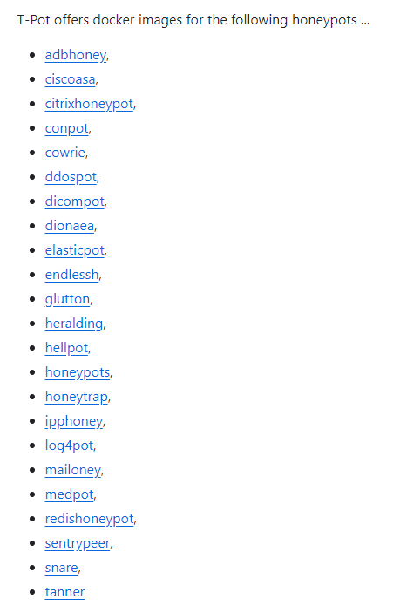
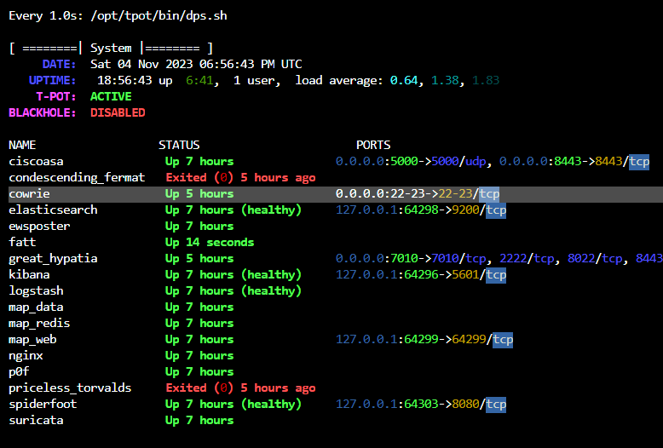
> BASELINE
IMPLEMENTED IN TPOT HONEYPOT
Original container
Modified container

Slide 13
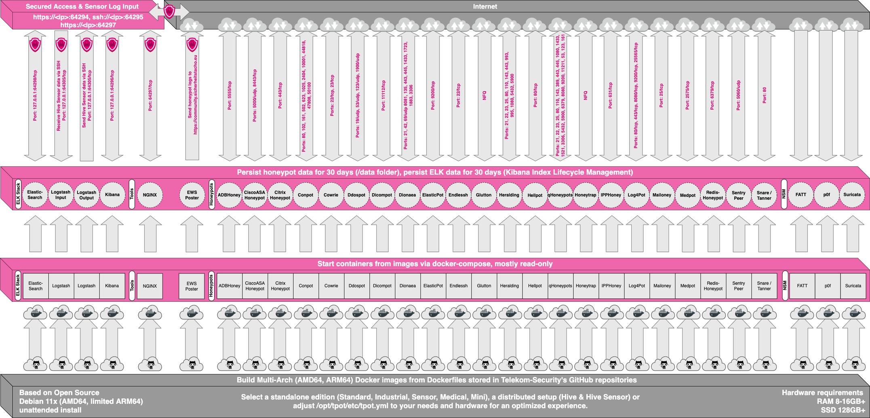
> BASELINE
IMPLEMENTED IN TPOT HONEYPOT

Slide 14
> BASELINE
IMPLEMENTED IN TPOT HONEYPOT
A few issues with TPOT Honeypot
> the default port to connect to the web UI of TPOT is 64294
> the default port to connect to the admin panel of TPOT is 64297
But, why is it prominent in our case?

Slide 15
> BASELINE
IMPLEMENTED IN TPOT HONEYPOT
Attacker’s Perspective

Slide 16
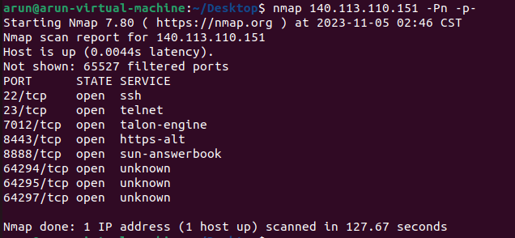
> BASELINE
IMPLEMENTED IN TPOT HONEYPOT
Lets consider a scenario, where an Attacker does a port scan
Very Suspicious!!!

Slide 17
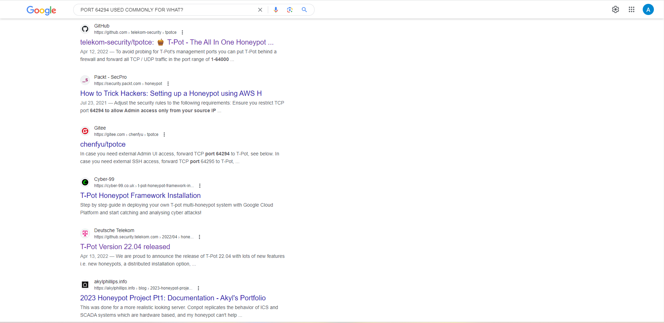
> BASELINE
IMPLEMENTED IN TPOT HONEYPOT
Very Very Suspicious!!!
-- > Recognized as Honeypot

Slide 18
> BASELINE
IMPLEMENTED IN TPOT HONEYPOT
2 Scenarios possible here
The attacker might recognize the honeypot and stop attacking the honeypot and look elsewhere
No RISK!
Or, the attacker might try to exploit the open port and might try to gain access to the honeypot and then try to access main server
High RISK!!
But how can this be done..??

Slide 19
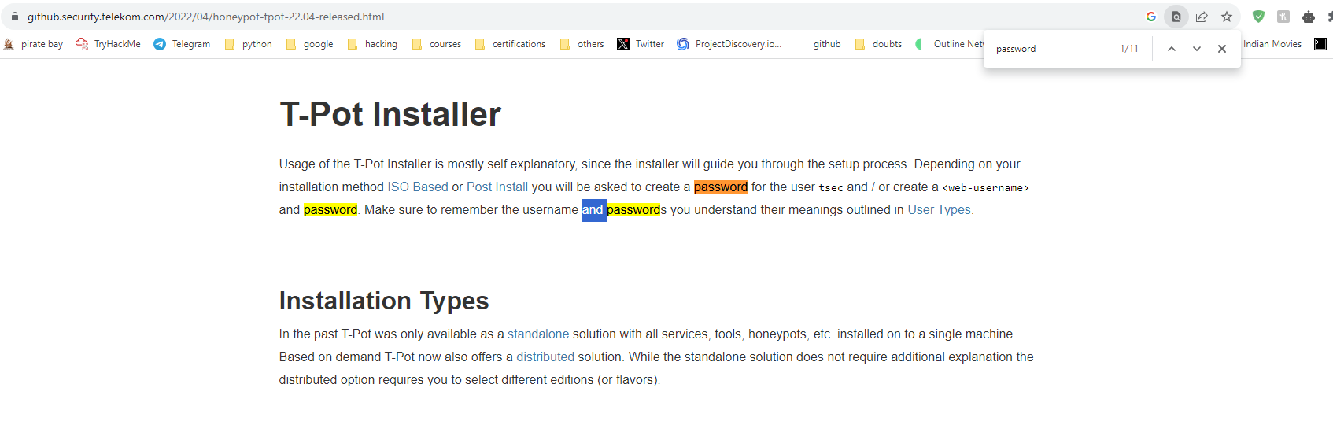
> BASELINE
IMPLEMENTED IN TPOT HONEYPOT
Using github documentation, Attacker gets to know that tsec is the default username for the web UI login.
Only worry is the password for the user tsec

Slide 20
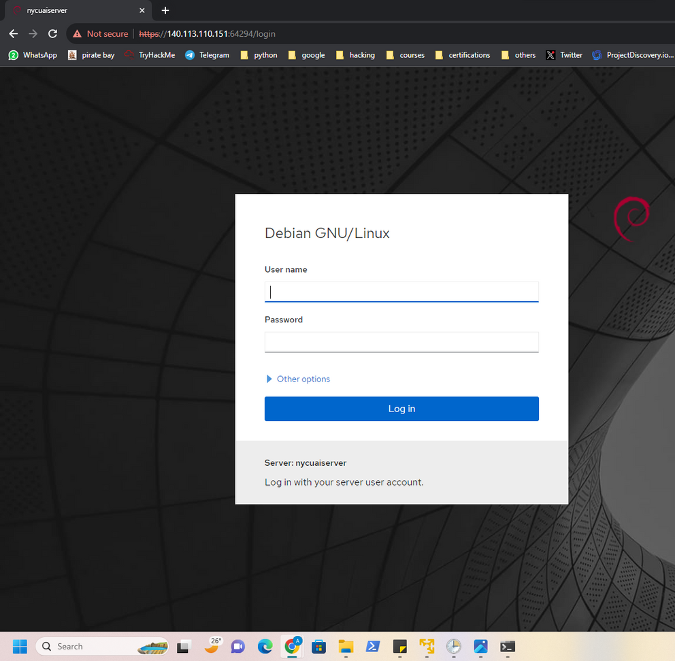
> BASELINE
IMPLEMENTED IN TPOT HONEYPOT
Default Username is Tsec // cant be changed
Whats the Password ..???
The server name is visible to anyone by default

Slide 21
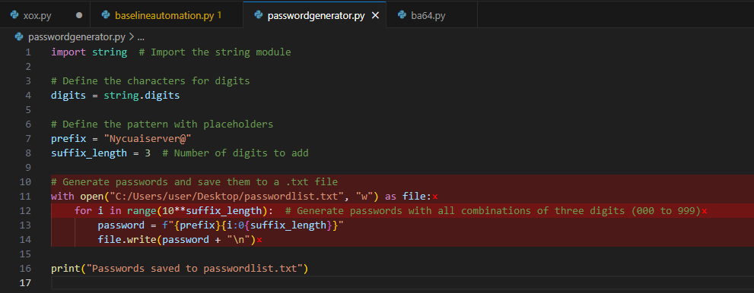
> BASELINE
IMPLEMENTED IN TPOT HONEYPOT
Passwords format is based on servername of the honeypot
generates passwordlist.txt file
Python code to generate Passwords for brute-forcing the honeypot web-UI

Slide 22
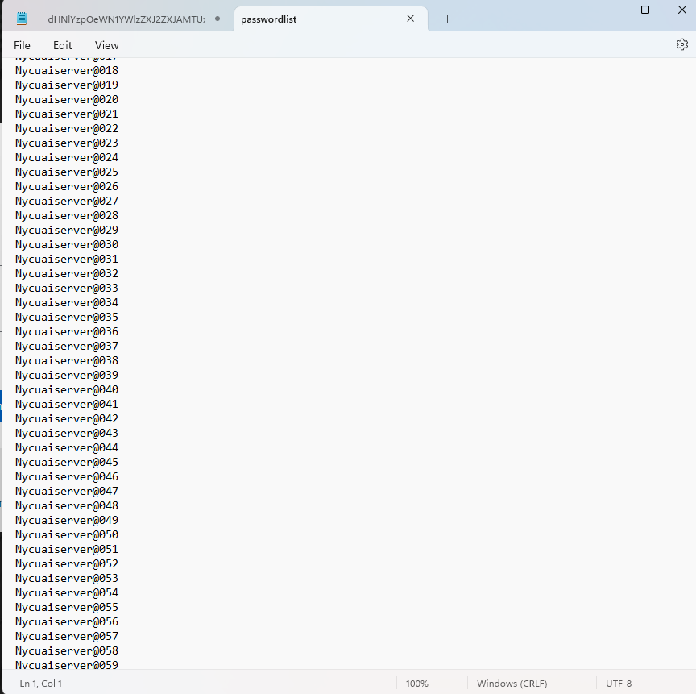
> BASELINE
IMPLEMENTED IN TPOT HONEYPOT
passwordlist.txt is generated by the Python code
Attacker uses this generated password list for bruteforcing the honeypot web UI using Burp suite
login page: https://140.113.110.151:64294/login

Slide 23
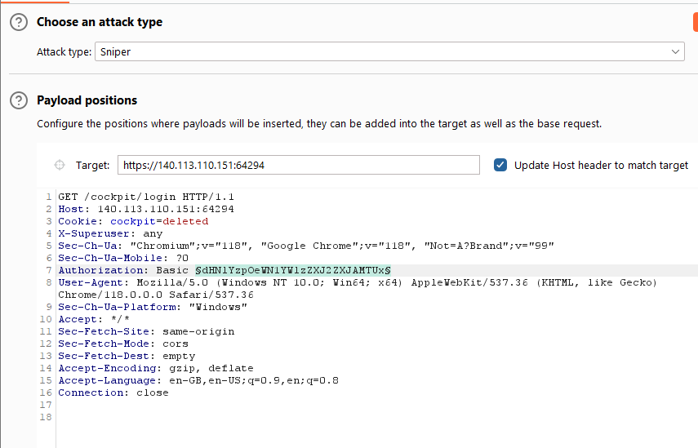
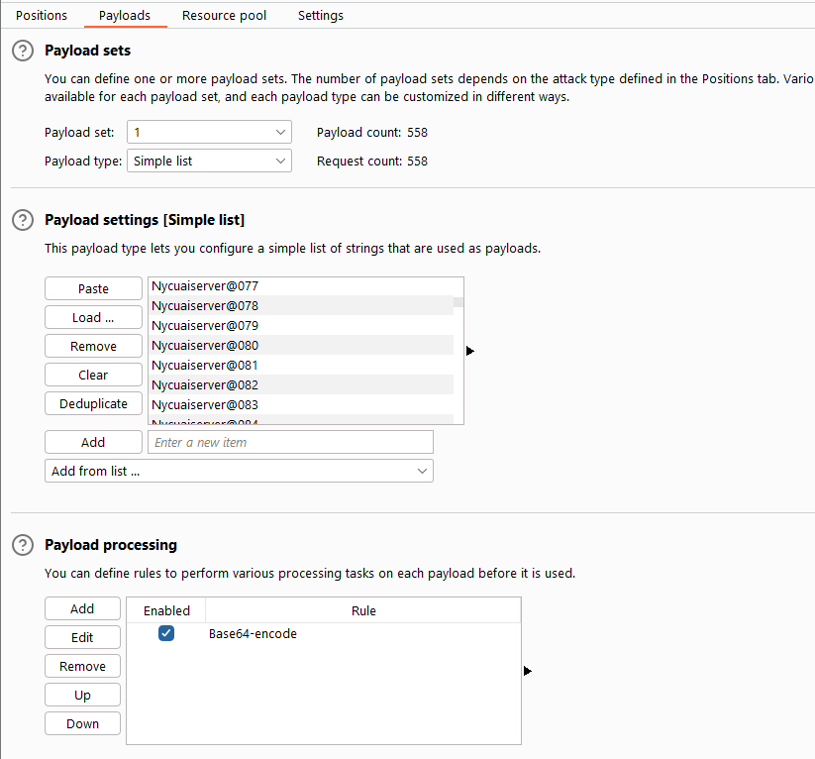
> BASELINE
IMPLEMENTED IN TPOT HONEYPOT
Using Burp suite to do a brute-force attack on the login page.
Password list is added

Slide 24
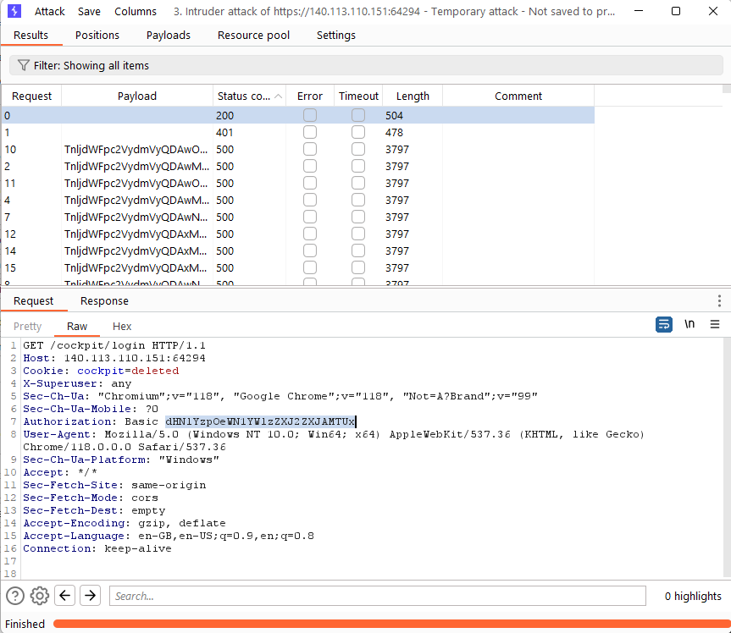
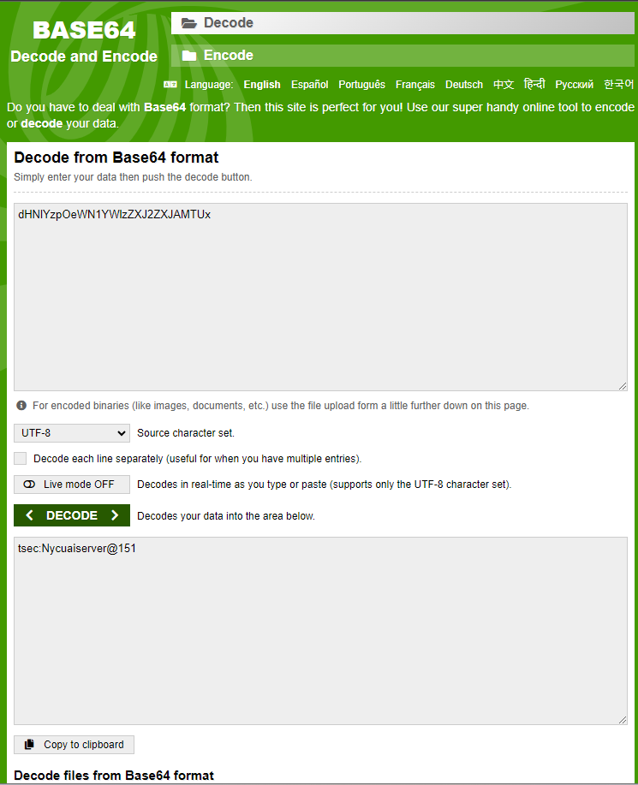
> BASELINE
IMPLEMENTED IN TPOT HONEYPOT
This is the passkey

Slide 25
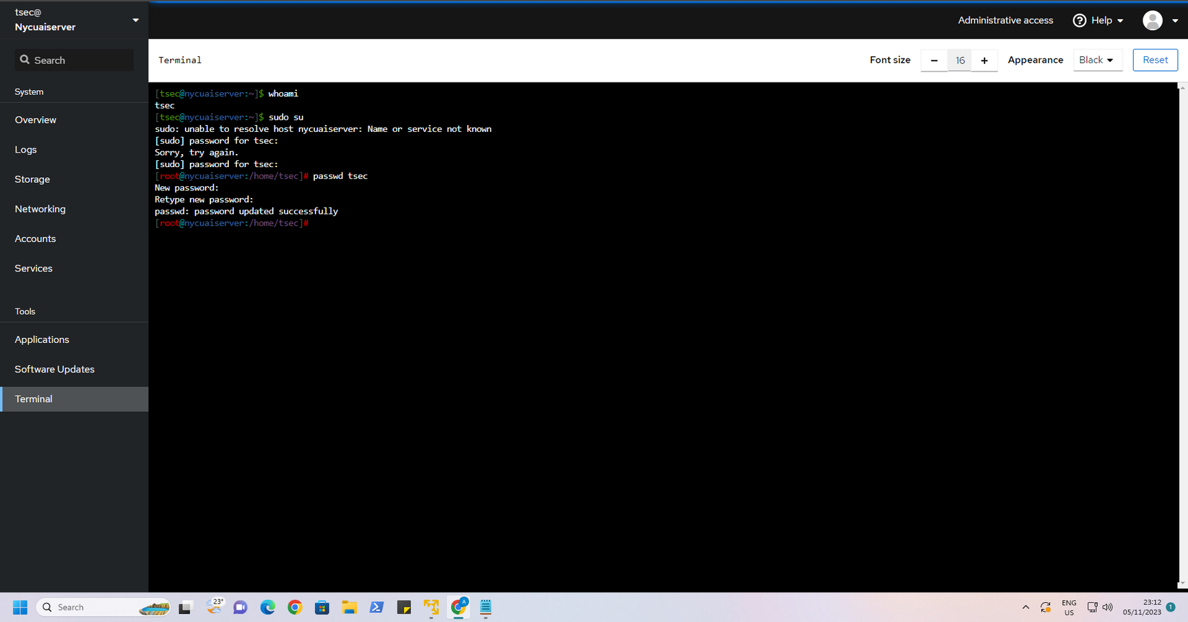
> BASELINE
IMPLEMENTED IN TPOT HONEYPOT
Attacker changed the password of the Honeypot, and now he has overall control of the honeypot system and we are kicked out of our own system !!!

Slide 26
> BASELINE
IMPLEMENTED IN TPOT HONEYPOT
Defender’s Perspective

Slide 27
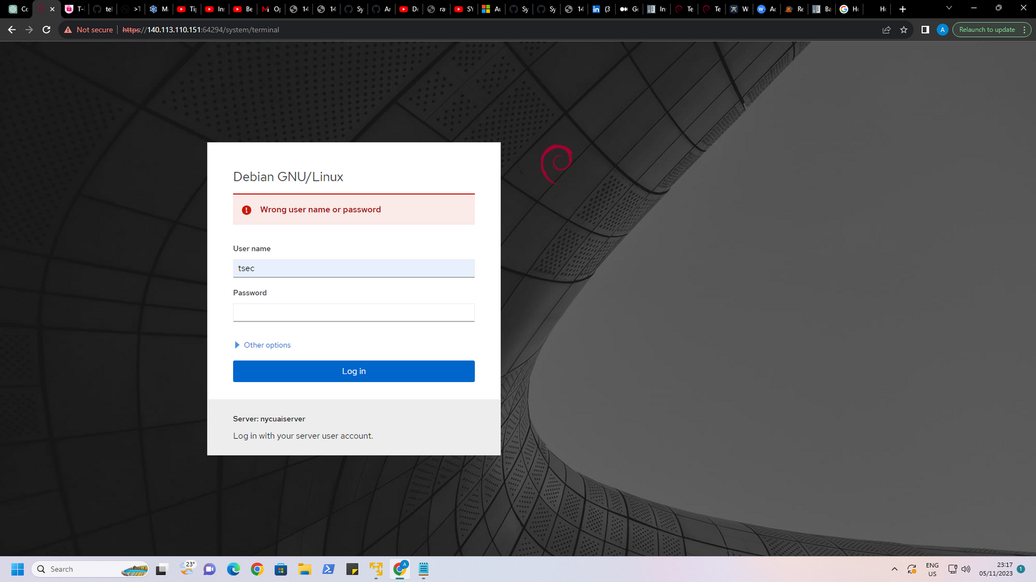
> BASELINE
IMPLEMENTED IN TPOT HONEYPOT
Now, we are kicked out of our own Honeypot.

Slide 28
> BASELINE
IMPLEMENTED IN TPOT HONEYPOT
What next..?
Attacker might attack the main production environment
Attacker might use this honeypot to compromise other servers
Attacker might use this as a bot in C&C and do DDoS attacks on other legitimate corporations

Slide 29
> BASELINE
IMPLEMENTED IN TPOT HONEYPOT
How to prevent this..??
We must implement baseline.
When something unpredictable happens, we must set the honeypot to baseline.
The honeypot will run from the baseline, as it was at the time of creating the baseline.
Lets do this implementation !!

Slide 30
> BASELINE
IMPLEMENTED IN TPOT HONEYPOT
Implementing the baseline
Set up the honeypot in a way in which we can implement it as a baseline.
Run the honeypot and verify if its working ;
If everything is correct, then shut down the honeypot and create a snapshot to be used as a baseline.

Slide 31
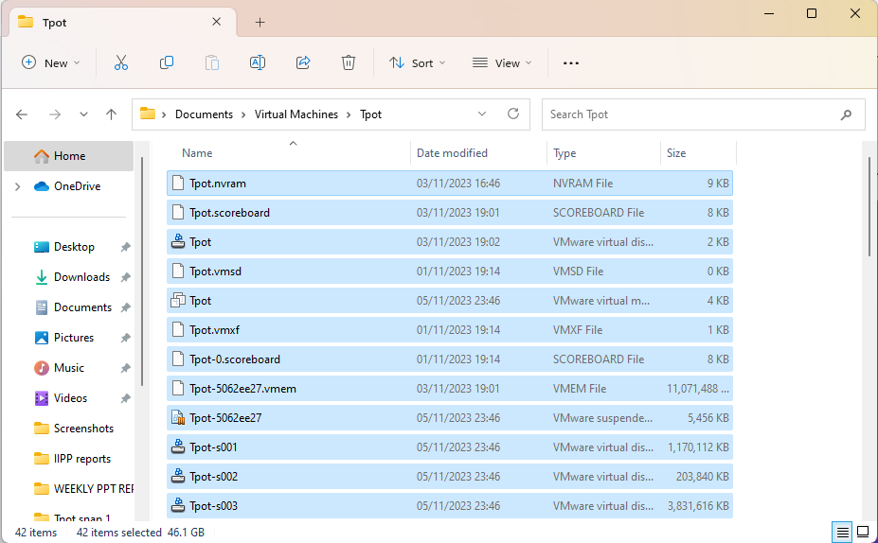
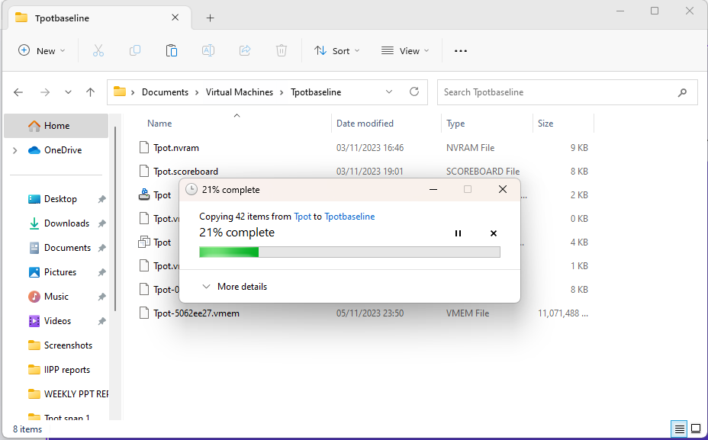
> BASELINE
IMPLEMENTED IN TPOT HONEYPOT
Tpotbaseline // vm name

Slide 32
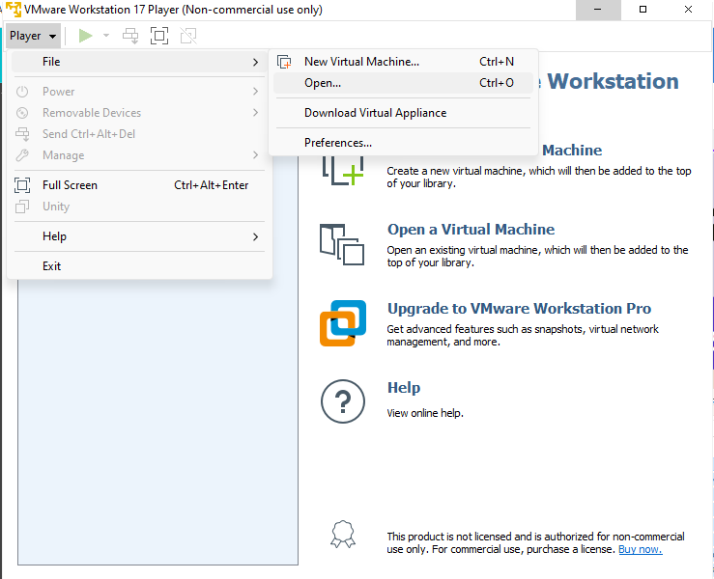
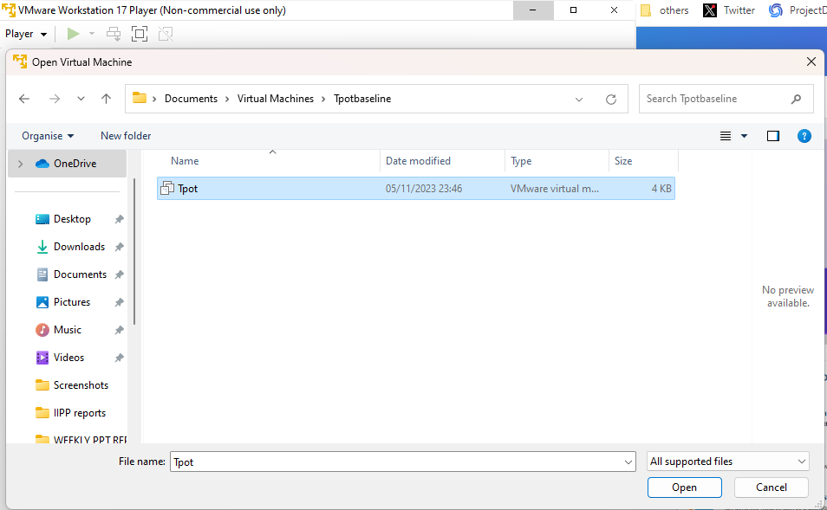
> BASELINE
IMPLEMENTED IN TPOT HONEYPOT
Tpotbaseline // vm name

Slide 33
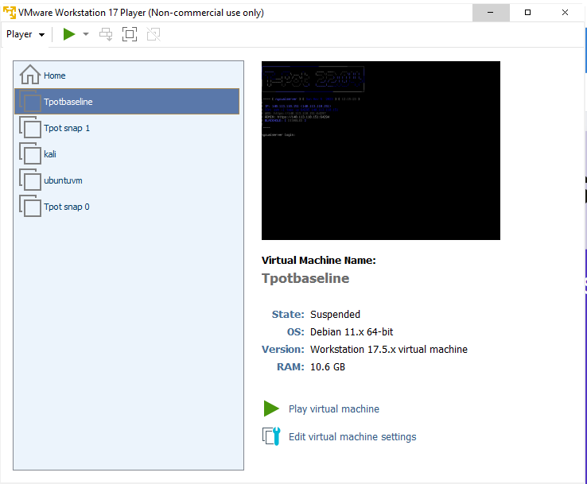
> BASELINE
IMPLEMENTED IN TPOT HONEYPOT
Tpotbaseline // vm name
Baseline is created, now lets setup the baseline

Slide 34
> BASELINE
IMPLEMENTED IN TPOT HONEYPOT
Tpotbaseline // vm name
Must have limited services running -->> Cowrie & Kibana
Must have only the required ports open -- >> port 22, 23, 64294
Password must be very complex -- >> WGTjsd4!%$5cd6@Hgc2G

Slide 35
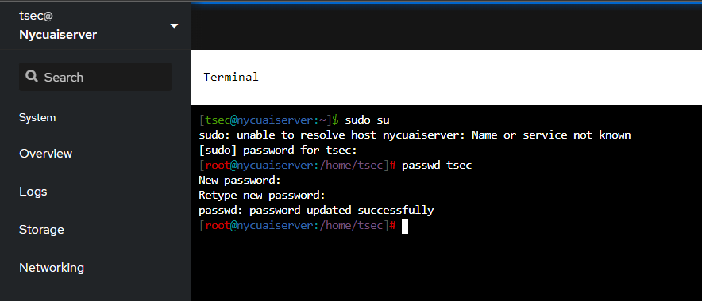
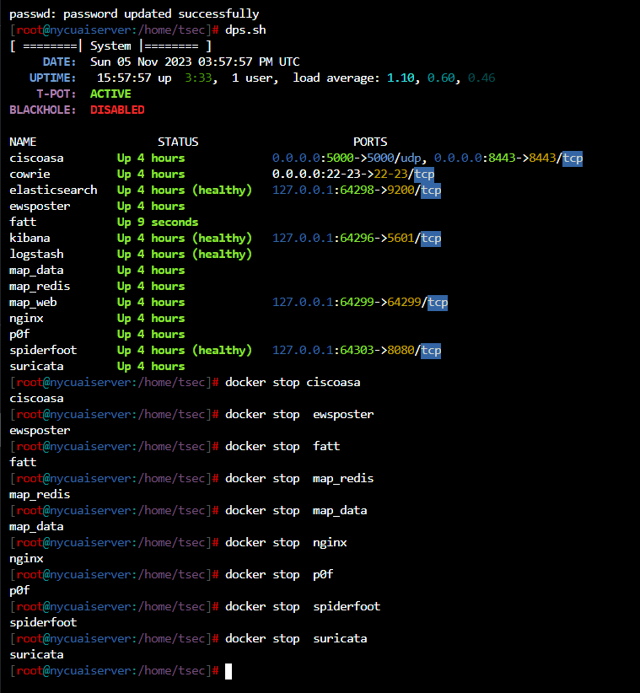
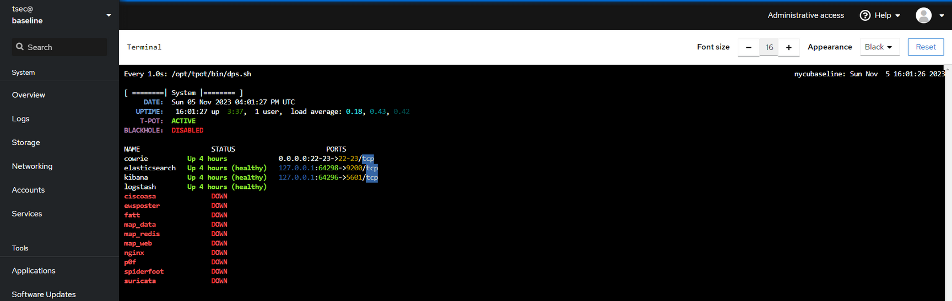
> BASELINE
IMPLEMENTED IN TPOT HONEYPOT

Slide 36
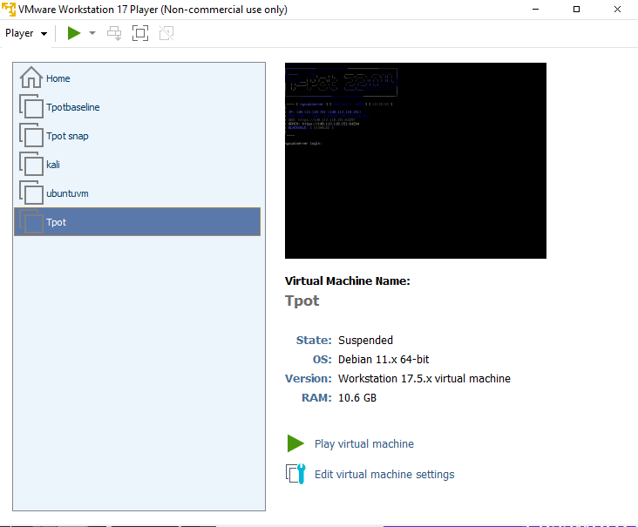
> BASELINE
IMPLEMENTED IN TPOT HONEYPOT
Tpot // Name of vm running Tpot Honeypot
This vm instance has all the services running and the password is very simple -->> Nycuaiserver@151
For now, this is the main Honeypot, that’s deployed in the environment

Slide 37
> BASELINE
IMPLEMENTED IN TPOT HONEYPOT
Scenario :
Attacker does a brute force on the login page of the Web-UI i.e 140.113.110.151:64294/login
and gets logged in into the honeypot system.
Once inside, he will change the password to lock us out and gain control of the entire Honeypot network
Once we get to know that the password is changed and we are locked out, we can immediately suspend the tpot vm instance and deploy the baseline vm instance and secure the environment.

Slide 38
> BASELINE
IMPLEMENTED IN TPOT HONEYPOT
But, something is missing ;
Lets add ‘Automation’ to deploy the baseline immediately, without any human interaction to better secure the environment
Advantages are :
Quick deployment
No Human Interaction needed
Can be deployed to monitor 24/7

Slide 39
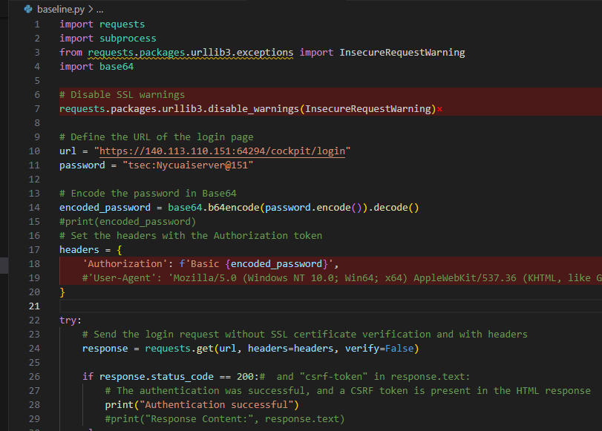
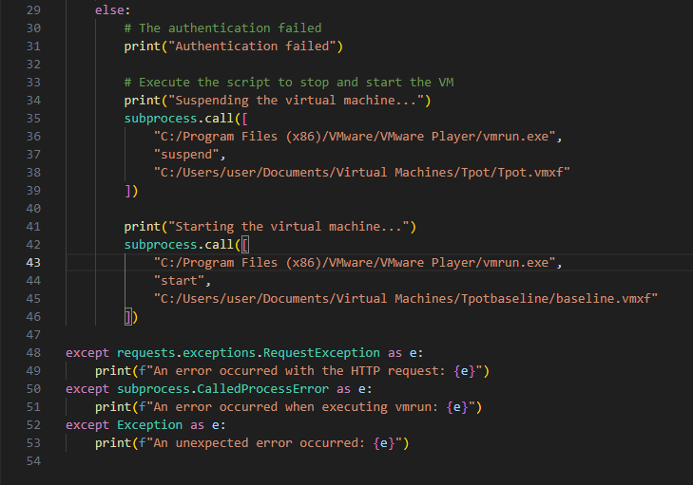
> BASELINE
IMPLEMENTED IN TPOT HONEYPOT
Lets code in python ;

Slide 40
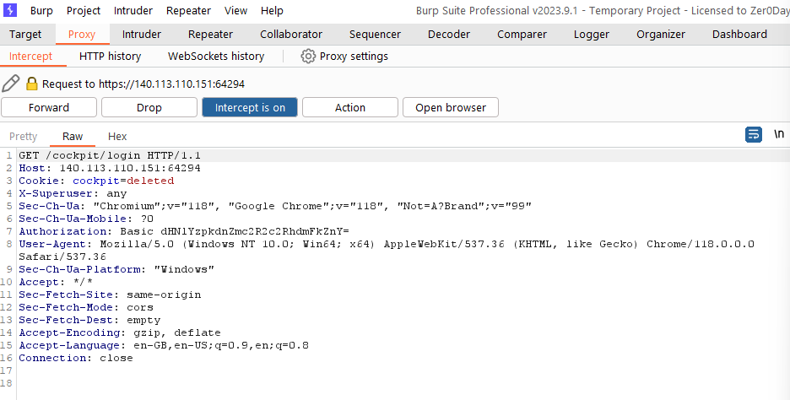
> BASELINE
IMPLEMENTED IN TPOT HONEYPOT
Why Encode the password ..?
The authorisation token accepts only the encoded value of the password being input

Slide 41
> BASELINE
IMPLEMENTED IN TPOT HONEYPOT
What happens actually in the code ..?
The script send a request to the url with the username as tsec and password as the current password i.e ‘Nycuaiserver@151’ and checks the response code.
If, 200 OK -->> Do Nothing, which means the Attackers hasnt locked us out
Else, Do the following ;
1. Stop the currently running Main Honeypot i.e Tpot
2. Start the baseline honeypot immediately i.e baseline

Slide 42
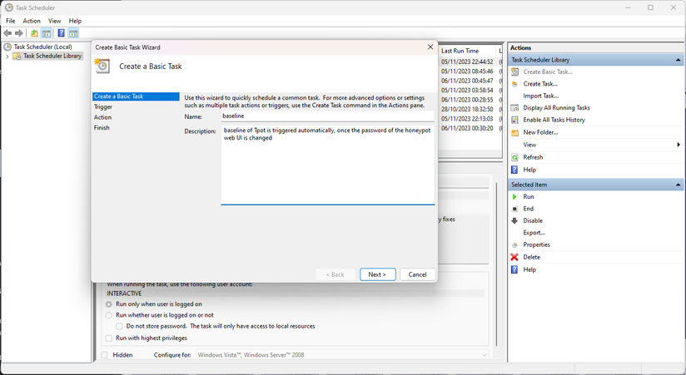
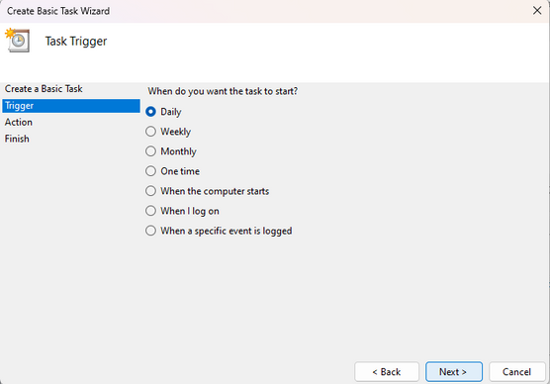
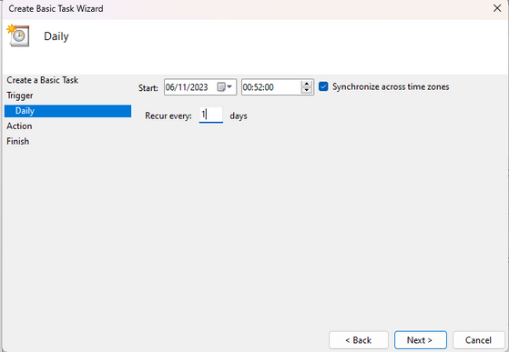
> BASELINE
IMPLEMENTED IN TPOT HONEYPOT
Lets make sure the script run every 1 minute. !!

Slide 43
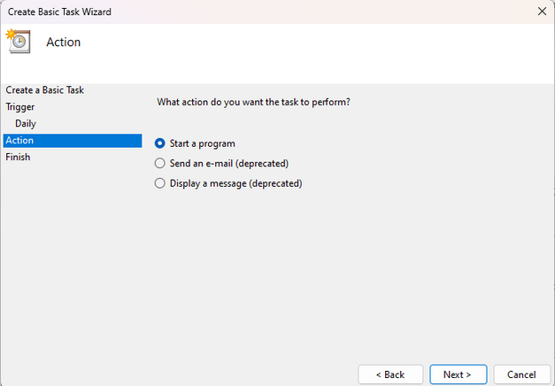
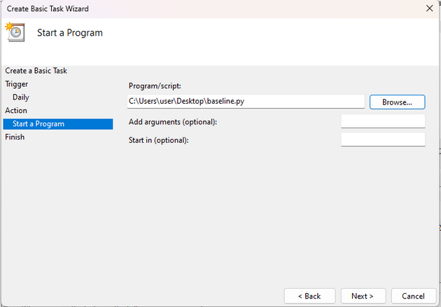
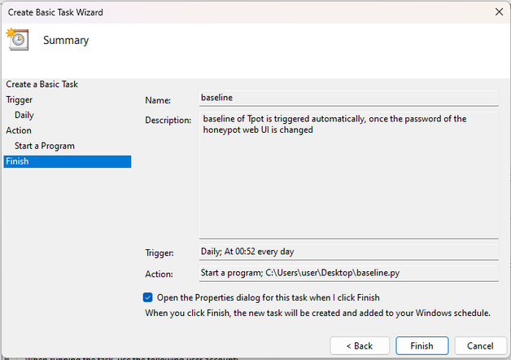
> BASELINE
IMPLEMENTED IN TPOT HONEYPOT
Lets make sure the script run every 1 minute. !!

Slide 44
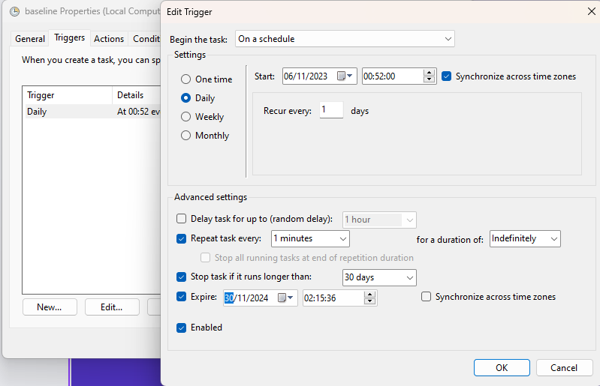
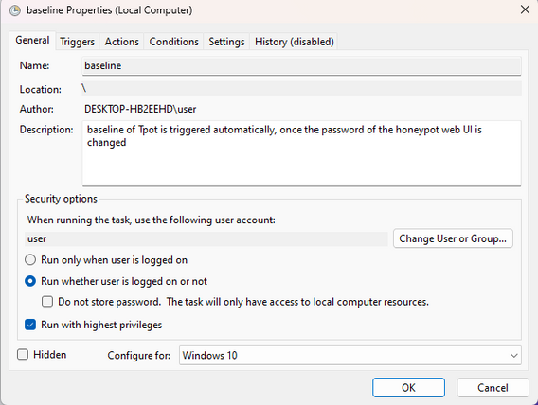
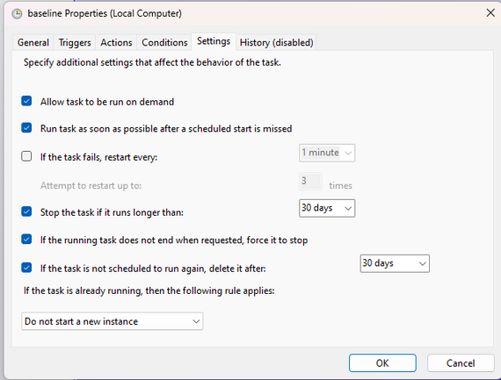
> BASELINE
IMPLEMENTED IN TPOT HONEYPOT
Lets make sure the script run every 1 minute. !!

Slide 45
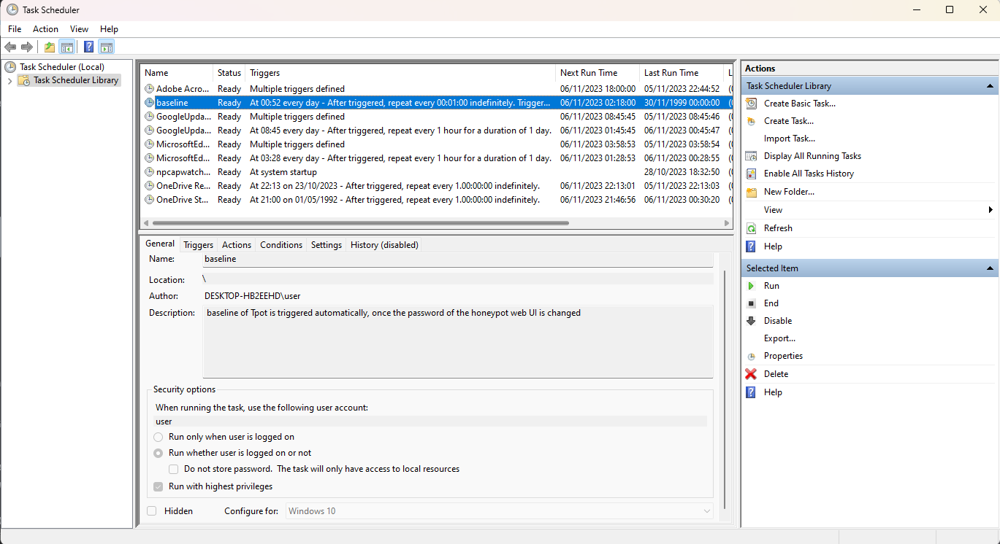
> BASELINE
IMPLEMENTED IN TPOT HONEYPOT
And, Its DONE !!

Slide 46

> BASELINE
IMPLEMENTED IN TPOT HONEYPOT
What happens now..?
The script is running in the background every minute and it tries to login once per minute.
If, logged in i.e 200 OK -- >> Do Nothing
Else, Do the following ;
1.Suspend ‘tpot’ vm instance
2.Start ‘baseline’ vm instance

Slide 47
> BASELINE
IMPLEMENTED IN TPOT HONEYPOT
Lets see the working from,
Attacker’s Perspective

Slide 48
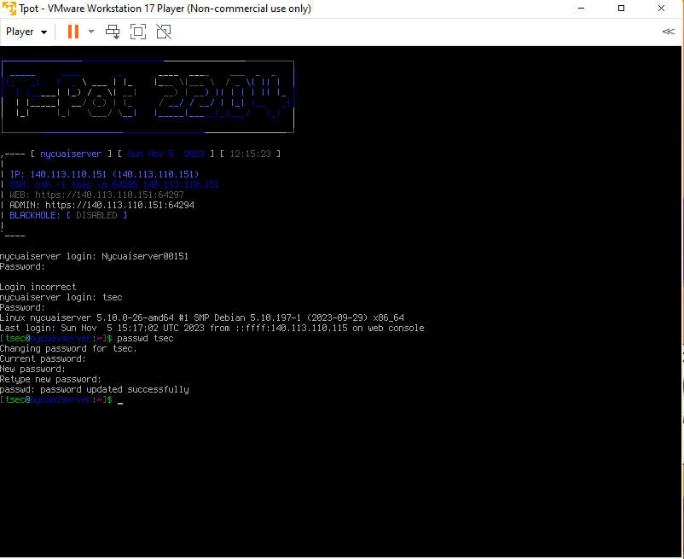
> BASELINE
IMPLEMENTED IN TPOT HONEYPOT
The Tpot honeypot is running normally with all the services
Attacker does a port scan and determines to hijack the honeypot using the web-UI port 64294
Uses Burp suite to do a brute-force attack on the web-UI and gets logged in into the system.

Slide 49
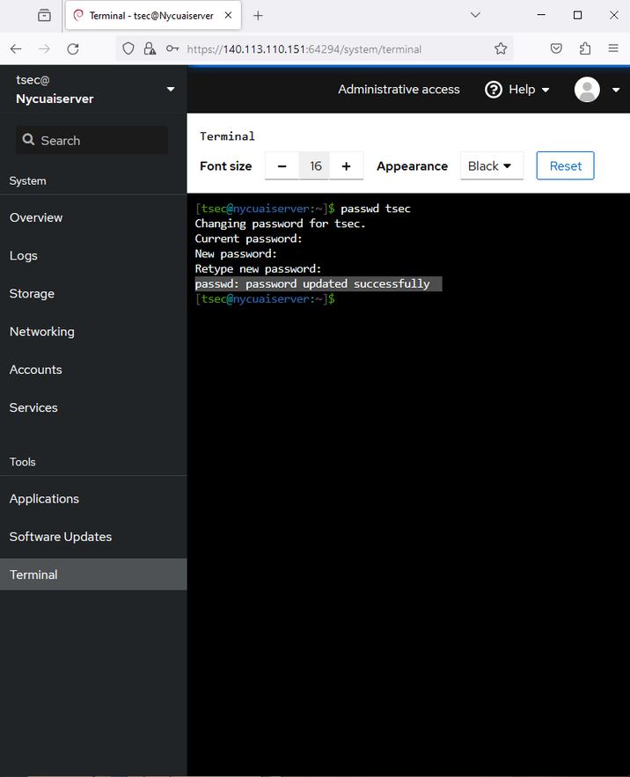
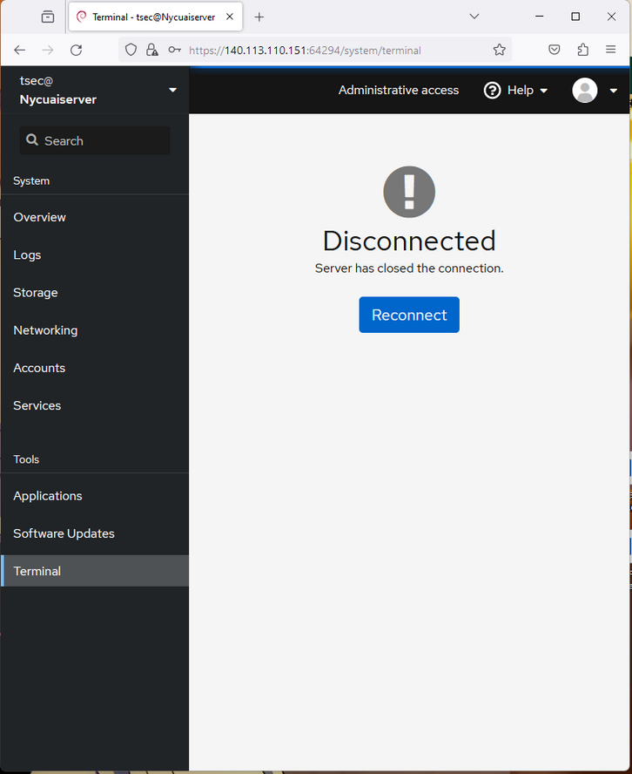
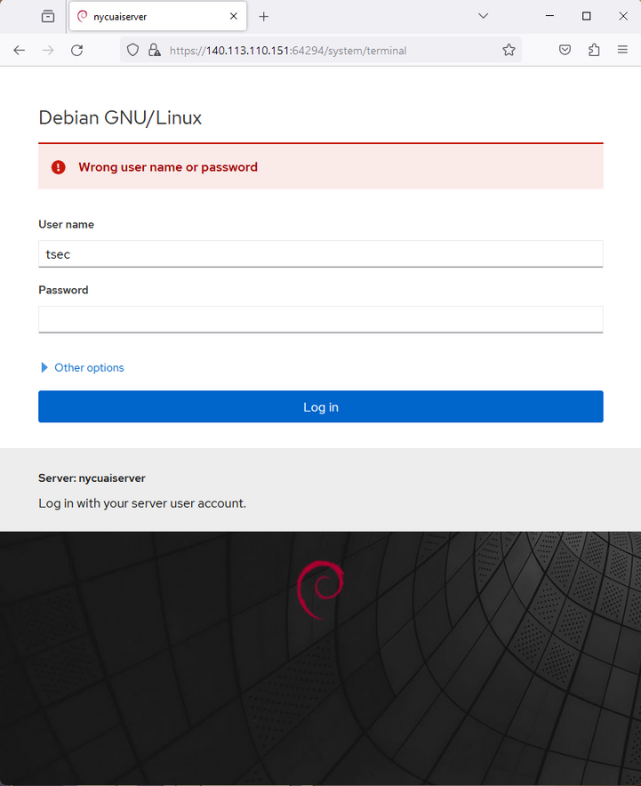
> BASELINE
IMPLEMENTED IN TPOT HONEYPOT
Once password is changed, the script is invoked !! // Happenings on Frontend
All within 1 minute

Slide 50
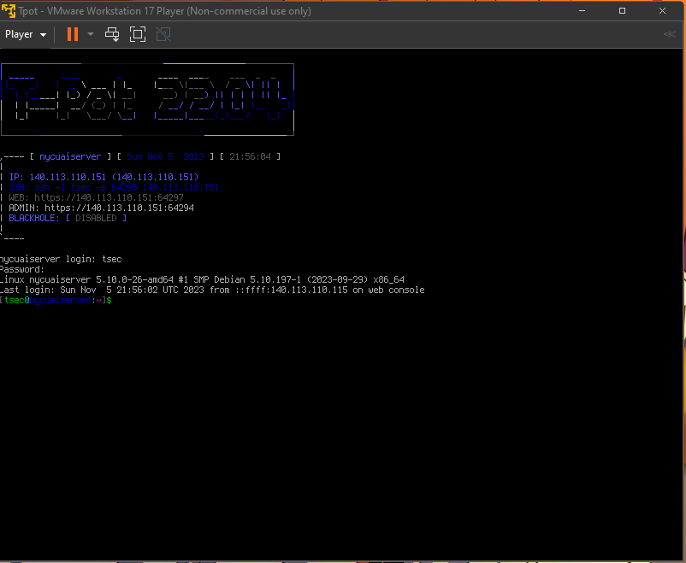
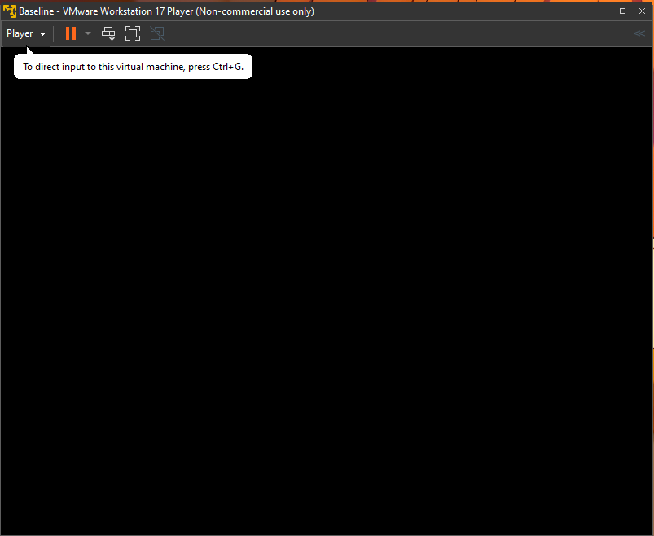
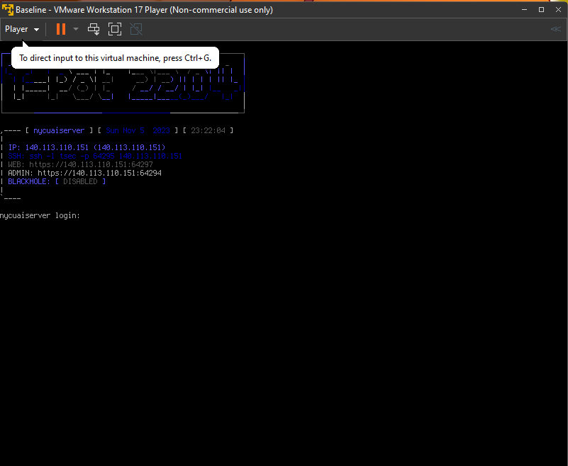
> BASELINE
IMPLEMENTED IN TPOT HONEYPOT
Once password is changed, the script is invoked !! // Happenings on Backend
All within 1 minute

Slide 51
> BASELINE
IMPLEMENTED IN TPOT HONEYPOT
Successfully deployed the Baseline for Tpot
This helps us in preventing the malicious actor from gaining access to the critical systems in the environment and even if the access is gained, with the help of baseline we can restore the system back to its safest form
With this, we have implemented the baseline of ‘Affect’ component

Slide 52
> BASELINE
IMPLEMENTED IN TPOT HONEYPOT
Goals achieved !
> Successful Implementation of Lures
> Successful Implementation of Baseline in Tpot
> Successful Automation of Baseline in Tpot

Slide 53
Thank
you!

